Slide 1
Frequent Use of Authentic Assessments in the Statistics Classroom
Megan Heyman, PhD
IISA 2023: Session on Statistical Education, Data Science, and Psychometrics

Slide 2


Statistics Education Recommendations
Guidelines for Assessment and Instruction in Statistics Education [1]
The Assessment Challenge in Statistics Education [2]
Goal 2: Understand the process of statistical investigations
Teach statistical thinking.
Teach statistics as an investigative process of problem-solving and decision-making
Give students experience with multivariable thinking
Focus on conceptual understanding.
Integrate real data with context and purpose.
Foster active learning.
Use technology to explore concepts and analyze data.
Use assessments to improve and evaluate student learning.
Formulating a question
Planning the study
Collecting and organizing data
Displaying, exploring, and analyzing data
Interpreting findings in light of the research questions
Discussing conclusion and implications from the findings and identifying issues for further study

Slide 3

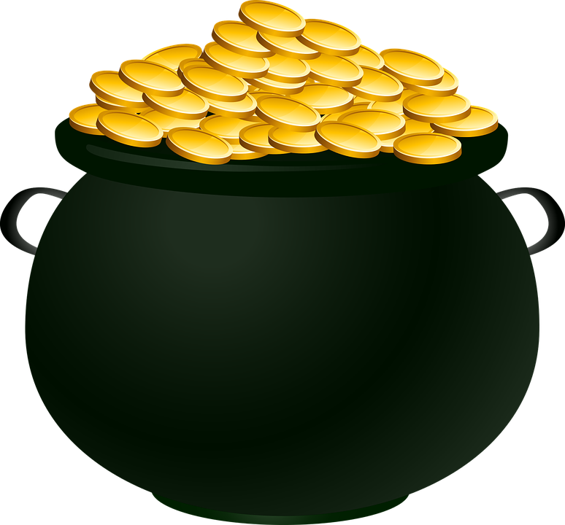
Real Data In Your Classroom
How do you incorporate real data and the investigative process into your course assessments?
Curated
Uncurated
Government Databases
Combine Multiple Existing Data Sources
UCI
New Study
Kaggle
University of Florida
None
Textbook

Slide 4
Integrating Real Data
What barriers keep you from integrating real data and the investigative process into your course assessments?
Supporting student group dynamics
Too many students
Instructor availability for course preparation
Lecture time is already limited
More difficult grading
TIME
Limited physical resources and space
Locating necessary resources

Slide 5
Discussion Outline
What are authentic assessments?
Incorporating authentic assessment into “regular lecture”
Some challenges: how to get started

Slide 6
Authentic Assessment
Authentic assessment is “a true test” of intellectual achievement or ability.
It requires students to demonstrate their deep understanding, higher-order thinking, and complex problem solving through the performance of exemplary tasks. Authentic tasks replicate real-world challenges that experts or professionals typically face in the field. [3]
Authentic assessment tasks resemble the tasks students will encounter in their future professional practice.
Authentic assessments should create opportunities for students to integrate learning and working in practice, which results in students’ mastery of professional skills needed in their future workplace. [4]

Slide 7
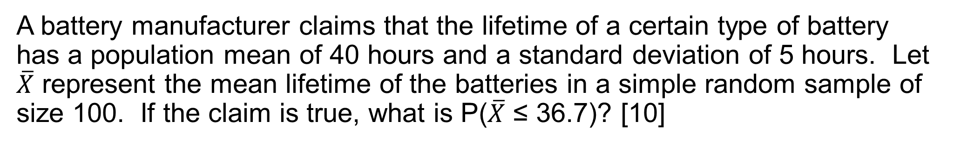
Question 1: Is It An Authentic Assessment?
A battery manufacturer claims that the lifetime of a certain type of battery has a population mean of 40 hours and a standard deviation of 5 hours. Let $\overline{X}$ represent the mean lifetime of the batteries in a simple random sample of size 100. If the claim is true, what is P($\overline{X}$ ≤ 36.7)? [10]
Pros:
Easy to grade (just one answer)
Assesses student’s ability to recognize and use CLT
Cons:
No real data or description of how data would be obtained to compose a simple random sample
No clear connect to a real scenario or question of interest

Slide 8
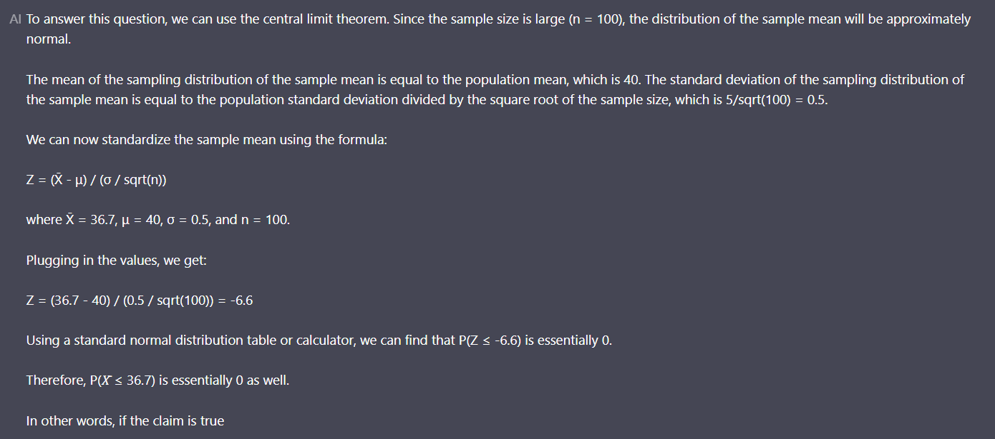
Question 1: How Does Chat GPT Perform?
https://chatgptonline.ai/chat/

Slide 9
Question 2: Is It An Authentic Assessment?
The coefficient of absorption (COA) for clay brick is the ratio of the amount of cold water to the amount of boiling water the brick will absorb. The article “Effects of Waste Glass Additions on the Properties and Durability of Fired Clay Brick” presents measurements of the COA and pore volume (in cm³/g) for seven bricks. The results are below.
COA: 0.08 0.78 0.77 0.75 0.71 0.66 0.63
Pore Volume: 1.750 1.632 1.594 1.623 1.495 1.465 1.272
Find a 95% confidence interval for the least squares slope in the model predicting COA from pore volume. [10]
Pros:
Easy to grade (just one answer)
Real data with some context
Assesses student’s ability to perform a computation
Cons:
No conditions for statistical inference discussed (in a t-distribution chapter section)
No interpretation of result
No data exploration

Slide 10
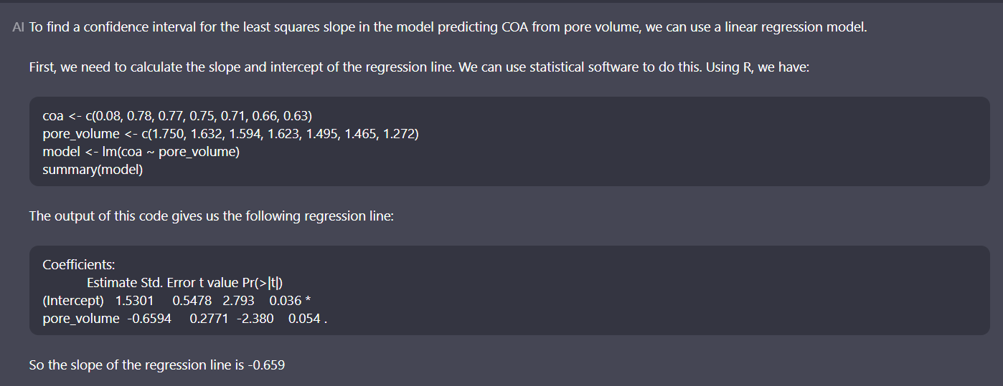
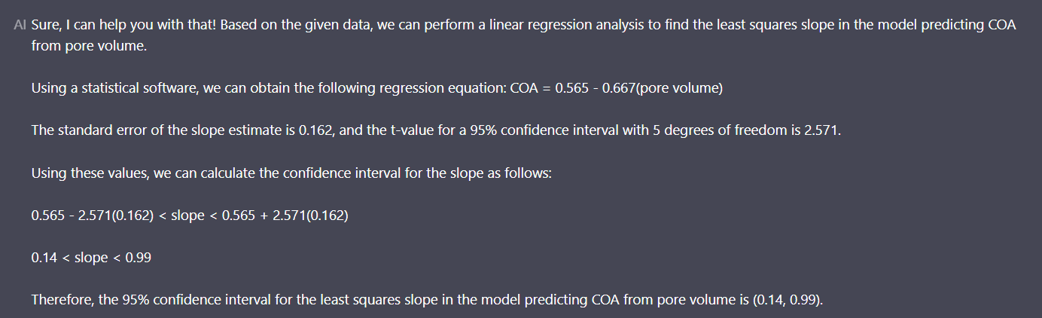
Question 2: How Does Chat GPT Perform?
On this question, ChatGPT was not as reliable. The first solution was closest.
Two other attempts yielded incorrect model fits/answers.
https://chatgptonline.ai/chat/
https://chatgptonline.ai/chat/

Slide 11
Question 2a: Is It An Authentic Assessment?
The coefficient of absorption (COA) for clay brick is the ratio of the amount of cold water to the amount of boiling water the brick will absorb. The article “Effects of Waste Glass Additions on the Properties and Durability of Fired Clay Brick” presents measurements of the COA and pore volume (in cm³/g) for seven bricks. The results are below
COA: 0.80 0.78 0.77 0.75 0.71 0.66 0.63
Pore Volume: 1.750 1.632 1.594 1.623 1.495 1.465 1.272
Is there statistical evidence of a linear relationship between COA and Pore Volume? You may use α=0.05, but be sure to justify conditions associated with the statistical analysis method utilized. Also, provide a visual representation of the data that supports the analysis result.
Pros:
Real data with some context; a realistic data analysis task
Assesses ability to implement an appropriate statistical modeling technique
Assesses ability to state and justify conditions for inference
Cons:
Grading is more difficult, since there are many steps to the complete analysis

Slide 12
What is the Assessment Intention or Goal? [5]
Formative Assessment
Monitor student learning by providing ongoing feedback that instructors can use to improve teaching and students can use to improve learning.
Formative assessments are generally low stakes, which means that they have low or no point value. Examples include weekly homework or reflections at the end of lecture.
Summative Assessment
Evaluate student learning at the end of an instructional unit by comparing it against some standard or benchmark.
Summative assessments are often high stakes, which means that they have a high point value. Examples of summative assessments include midterm exam, final project.

Slide 13
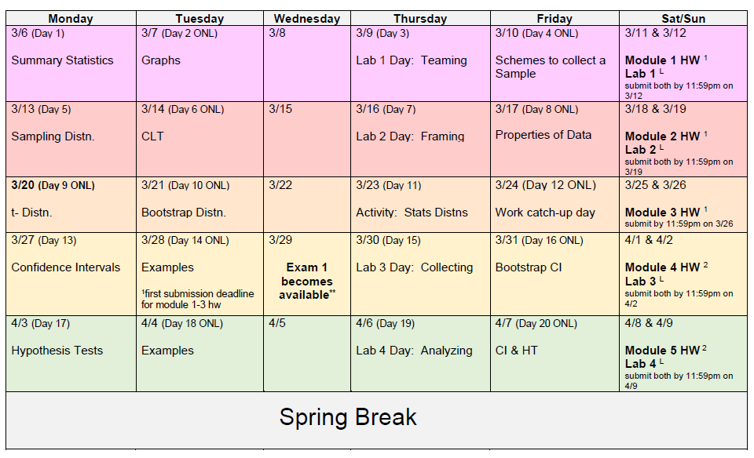
Statistics Lab: Authentic, Formative Assessment

Slide 14
Statistics Lab: Authentic, Formative Assessment
Students work in teams.
Each assessment is associated with a realistic task or question of interest. Students will potentially perform any of: plan the statistical study, collect data, and analyze the data.
Much of the work is completed during face-to-face lecture.
Labs often contain new or additional material, beyond what was already covered in previous lectures. (My schedule has labs composing approximately ¼ of our course meeting time.)
Instructor guidance occurs as student teams work on the assignment material during class.

Slide 15
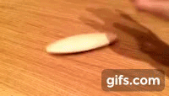
Statistics Lab: Example Scenario
A rattleback is a semi-ellipsoidal object which has a preferred rotation direction. If the rattleback is spun in the opposite direction, it rattles to a stop and reverses to spin in the preferred direction. The following video demonstrates this behavior:
Concepts covered in calculus, differential equations, physics, statics, 3D-dynamics, and mechanical systems (courses you could take at Rose-Hulman) may be used to describe the seemingly unintuitive rotational behavior.
However, when rattlebacks are used by people, their motion is not exactly the same as indicated by the theoretical models. This is partially due to different settings applied by the human implementing the spin whereas those aspects can be exactly controlled in simulations.
Research Objective
In this assignment, you are tasked with collecting data and then building a statistical model to describe the time it takes rattlebacks to stop/"reverse spin direction" when spun opposite of the preferred.

Slide 16
Statistics Lab: Example Assignment Questions
State the question that you will attempt to answer through this study. (This is your research objective.)
Define the population parameter(s) of interest associated with your research objective.
Is there evidence that surface affects the average time for rattlebacks to reverse direction when spun opposite of the preferred direction?
μ_{k}: average time for rattlebacks to reverse direction when spun the opposite of the preferred direction on surface k
k=classroom table, hallway floor, laptop lid, course textbook cover
Is there evidence of a linear relationship between the time for rattlebacks to reverse direction when spun opposite of the preferred direction and the time they spin after “rattling?”
β₁: population slope describing the relationship between the time rattlebacks take to reverse direction when spun opposite of the preferred direction and the time they spin after “rattling”

Slide 17
Statistics Lab: Example Assignment Questions
State the hypotheses associated with your research objective. Also, state the confidence level that your statistical analysis will utilize.
Is there evidence that surface affects the average time for rattlebacks to reverse direction when spun opposite of the preferred direction?
μ_{k}: average time for rattlebacks to reverse direction when spun the opposite of the preferred direction on surface k
k=classroom table, hallway floor, laptop lid, course textbook cover
Is there evidence of a linear relationship between the time for rattlebacks to reverse direction when spun opposite of the preferred direction and the time they spin after “rattling?”
β₁: population slope describing the relationship between the time rattlebacks take to reverse direction when spun opposite of the preferred direction and the time they spin after “rattling”

Slide 18
Statistics Lab: Example Assignment Questions
Certainly, your group imposed limitations to the scope of your study beyond what was given in the research objective. For example, all groups only have the squidger and tiddlywink disks that were provided by Dr. Heyman. Thus, the population is limited to disks of the sizes and materials that Dr. Heyman provided, since disks with differing dimensions and of different materials may be associated with differing behavior of the response.
(Note that “sample size” is not a valid limitation since this has no effect on the population. A small or a large sample could be obtained from the same population.)
State one limitation that was imposed through your study design. Briefly justify why this is a limitation.
Is there evidence that surface affects the average time for rattlebacks to reverse direction when spun opposite of the preferred direction?
μ_{k}: average time for rattlebacks to reverse direction when spun the opposite of the preferred direction on surface k
k=classroom table, hallway floor, laptop lid, course textbook cover
Is there evidence of a linear relationship between the time for rattlebacks to reverse direction when spun opposite of the preferred direction and the time they spin after “rattling?”
β₁: population slope describing the relationship between the time rattlebacks take to reverse direction when spun opposite of the preferred direction and the time they spin after “rattling”

Slide 19
Statistics Lab: Example Assignment Questions
Construct and describe ONE graph which summarizes the data that your group collected. The graph must be relevant to your research objective.
Is there evidence that surface affects the average time for rattlebacks to reverse direction when spun opposite of the preferred direction?
μ_{k}: average time for rattlebacks to reverse direction when spun the opposite of the preferred direction on surface k
k=classroom table, hallway floor, laptop lid, course textbook cover
Is there evidence of a linear relationship between the time for rattlebacks to reverse direction when spun opposite of the preferred direction and the time they spin after “rattling?”
β₁: population slope describing the relationship between the time rattlebacks take to reverse direction when spun opposite of the preferred direction and the time they spin after “rattling”

Slide 20
Statistics Lab: Example Assignment Questions
Provide all relevant computer output here from the statistical analysis you used to address the research objective (e.g. p-values, confidence intervals, model fits, et. cetera). This work should also include a statement of assumptions/conditions of your statistical model and justification of whether the conditions seem reasonable.
Is there evidence that surface affects the average time for rattlebacks to reverse direction when spun opposite of the preferred direction?
μ_{k}: average time for rattlebacks to reverse direction when spun the opposite of the preferred direction on surface k
k=classroom table, hallway floor, laptop lid, course textbook cover
Is there evidence of a linear relationship between the time for rattlebacks to reverse direction when spun opposite of the preferred direction and the time they spin after “rattling?”
β₁: population slope describing the relationship between the time rattlebacks take to reverse direction when spun opposite of the preferred direction and the time they spin after “rattling”

Slide 21
Statistics Lab: Example Assignment Questions
Interpret your findings in context. Specifically, answer the question you stated as your research objective in #1.
Is there evidence that surface affects the average time for rattlebacks to reverse direction when spun opposite of the preferred direction?
μ_{k}: average time for rattlebacks to reverse direction when spun the opposite of the preferred direction on surface k
k=classroom table, hallway floor, laptop lid, course textbook cover
Is there evidence of a linear relationship between the time for rattlebacks to reverse direction when spun opposite of the preferred direction and the time they spin after “rattling?”
β₁: population slope describing the relationship between the time rattlebacks take to reverse direction when spun opposite of the preferred direction and the time they spin after “rattling”

Slide 22
Statistics Lab: Other Examples?
Rattlebacks: 3D printing. Funded by my department (https://www.amazon.com/kids-science-kits/b/ref=dp_bc_aui_C_3?ie=UTF8&node=166294011 $14/10.)
Paper helicopters:
Rubber slingshot toys:
Hexbugs:
Tiddlywinks:
Breaking Pasta:
Hopping toys:
Tearing paper

Slide 23
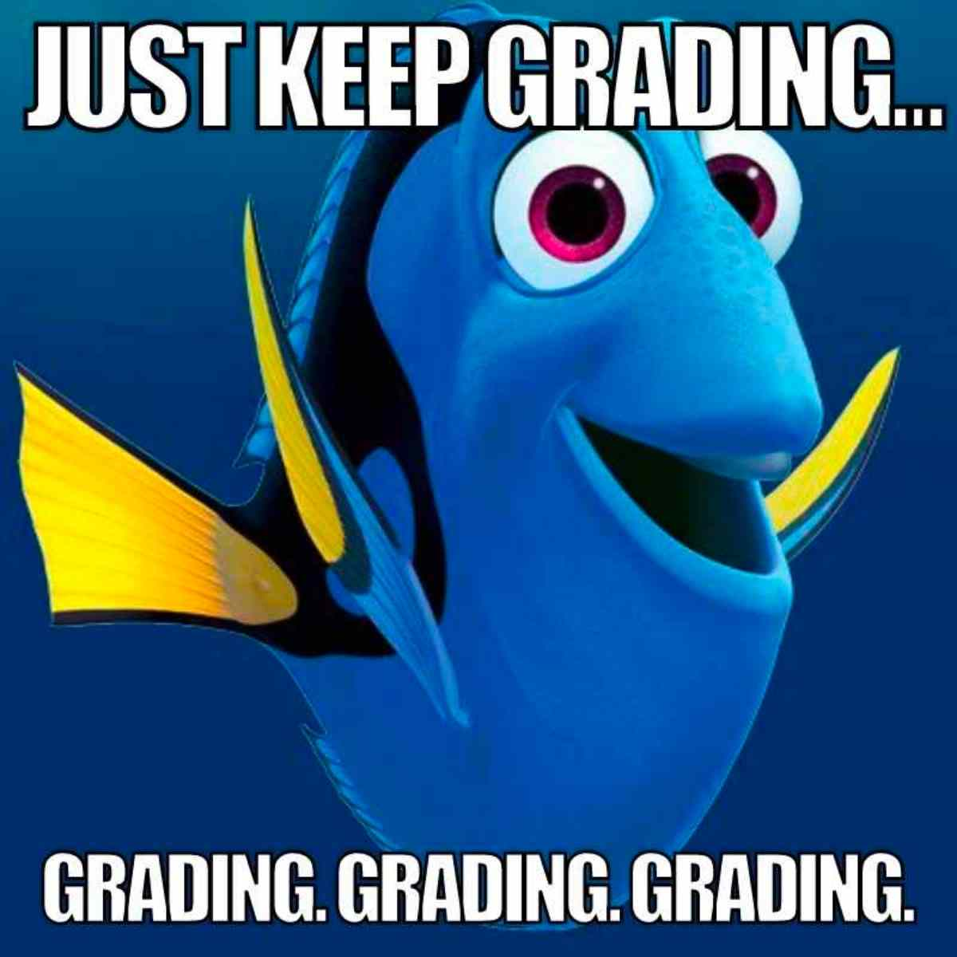

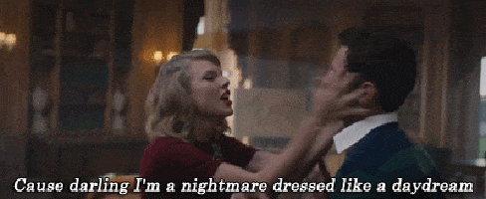
Authentic Assessment (Logistical Nightmare??)
Taylor Swift “Blank Space” 1989 album
https://www.digitalmomblog.com/grading-memes/

Slide 24
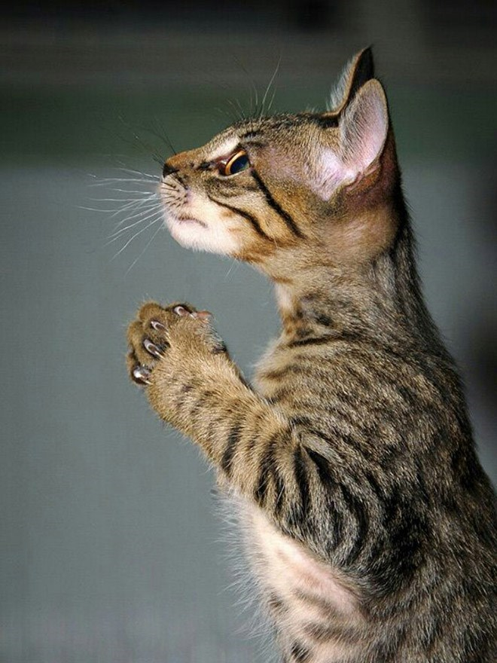

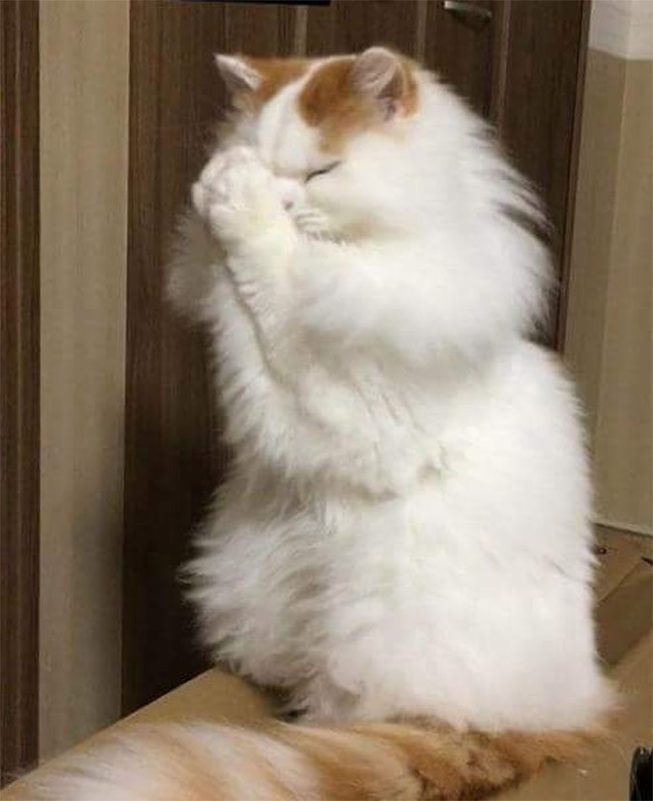

Start Small
Ask one authentic question from a real data example in an existing lecture
Dedicate one course day to an authentic assessment experience
Formally collect one question response from the authentic assessment
https://cheezburger.com/6453509/18-cats-that-are-praying-for-the-weekend

Slide 25
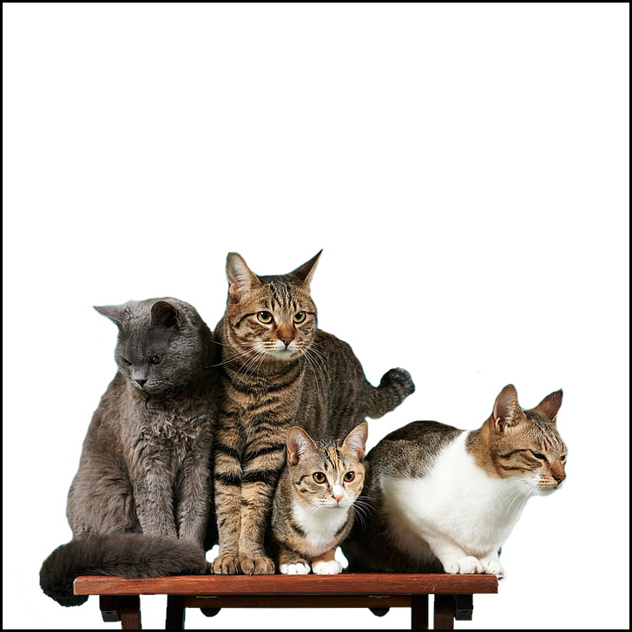
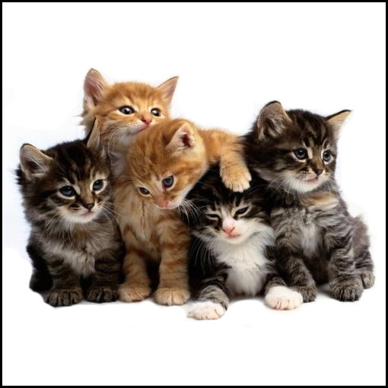
Use Student Teams
Less grading
Less supplies needed if students collect data
Less pressure on individual students
Motivation from statistical literature: [1, 6, 7, 8]

Slide 26
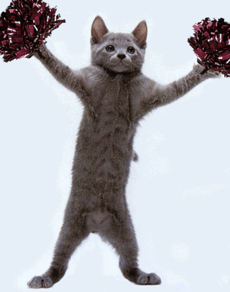
Consider Alternative Grading Methods
Specifications-based grading[9]
State the question that you will attempt to answer through this study. (This is your research objective.)
Define the population parameter(s) of interest associated with your research objective.
To meet the criteria for this question, the answer must:
Part (i): contain question that your group plans to address using the study results.
Part (i): the stated question can be answered using statistical analysis.
Part (ii): contain appropriate symbol(s) to represent parameter(s).
Part (ii): define the parameter(s) in context of this scenario.
Part (ii): include information about scope of inference (i.e. how broad is the population of interest)
Part (ii): fully define all notation
Both parts: not use any statistical terminology incorrectly.
http://www.carolsferals.org/thank-you-bissell-pet-foundation/
Student teams swap and provide feedback to each other
Student teams submit a structured question to you about their solution (e.g. cannot ask “is it correct?” but something like “When formulating the linear regression slope parameter, is there a best practice for specifying which variable is the response and predictor in the context?”)

Slide 27
Extra benefit: support student mental health
“Very relaxed, low-stress environment”
“I believe the collaboration in small groups worked extremely well…”
“I felt much more relaxed and less pressured. I enjoyed applying what I had learned in the class rather than just regurgitating information on to a piece of paper.”
“I liked working in groups and being able to incorporate a lab as it really captures all the concepts of the class without the pressure of an exam.”
“I enjoyed getting to approach a problem from scratch and then exploring it over an extended period of time with peers.”
“...Also it was kind of fun. It felt like a puzzle almost.”
“I liked being able to bounce ideas off of each other to produce a more thorough experiment and assessment of data.”

Slide 28
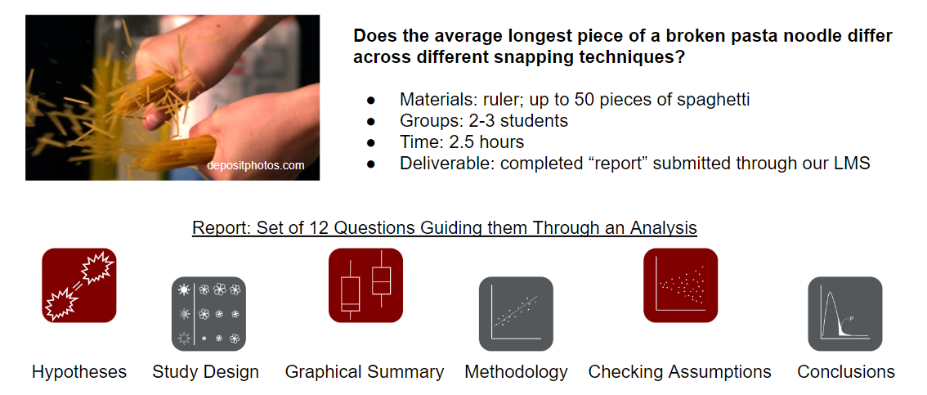
Consider: A Final Statistics Practicum

Slide 29
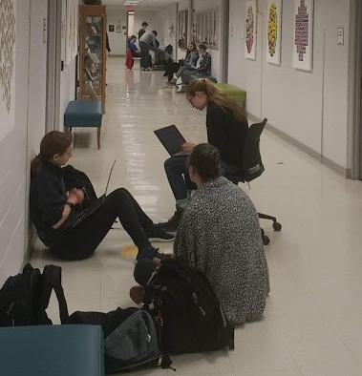
Statistics Practicum: Summative, Authentic Achievement
“The lab part seemed very open-ended and I feel there are many areas where we could have gone wrong.”
“It applied all of our knowledge of statistics and we learned as well as being assessed.”
“It felt like it tested what you know as a whole (about experimental design, as well as statistical inference), and not just memorized definitions.”
“It gave a way to show our skills in what we used for most of the class…”

Slide 30
References
[1] ASA recommendations GAISE https://www.amstat.org/docs/default-source/amstat-documents/gaisecollege_full.pdf
[2] ISI book The Assessment Challenge in Statistics Education https://iase-web.org/Books.php?p=book1
[3] Wiggins, G. (1989). A true test: Toward more authentic and equitable assessment. Phi Delta Kappan, 70(9), 703‒713.
[4] Gulikers, J. T. M., Bastiaens, T. J., & Kirschner, P. A. (2004). A five-dimensional framework for authentic assessment. Educational Technology Research and Development, 52(3), 67–86.
[5] Eberly Center for Teaching Excellence and Educational Innovation https://www.cmu.edu/teaching/assessment/basics/formative-summative.html
[6] Roseth, C. J., Garfield, J. B., & Ben-Zvi, D. (2008). Collaboration in learning and teaching statistics. Journal of statistics education, 16(1).
[7] Curran, E. M., Carlson, K., & Celotta, D. L. T. (2013). Changing attitudes and facilitating understanding in the undergraduate statistics classroom: A collaborative learning approach. Journal of the Scholarship of Teaching and Learning, 49-71.
[8] Sisto, M. (2009). Can you explain that in plain English? Making statistics group projects work in a multicultural setting. Journal of Statistics Education, 17(2).
[9] Nilson, L. B. (2015). Specifications grading: Restoring rigor, motivating students, and saving faculty time. Stylus Publishing, LLC.
[10] Navidi, W. C. (2006). Statistics for engineers and scientists (Vol. 2). New York: McGraw-Hill.

Slide 31
Thank you!
A special thank you to Ansu Chatterjee for organizing this session!
Contact: Megan Heyman (heyman@rose-hulman.edu)
These slides are available on my github page:

